Slide 1
SNS ACADEMY
A fingerprint International School
Affiliated to CBSE New Delhi
Affiliation No :1930610
GRADE XII A (2020-21)
COURSE NAME :BIOLGY(042)
Chapter-5 PRINCIPLES OF INHERIANCE – MENDELIAN DISORDERS

Slide 2
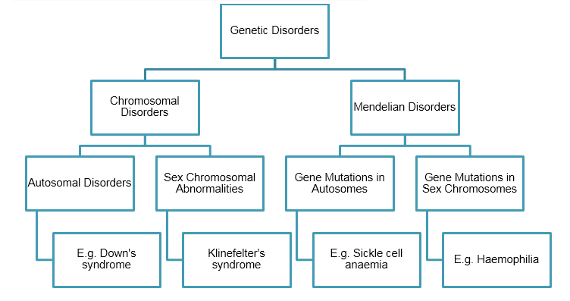
MENDELIAN DISORDERS

Slide 3
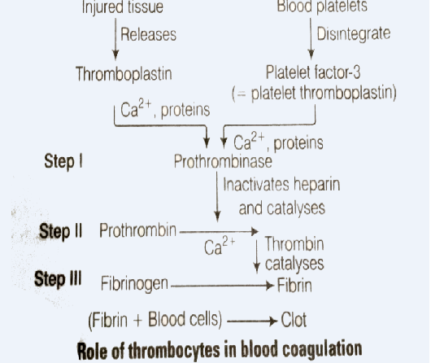

Slide 4
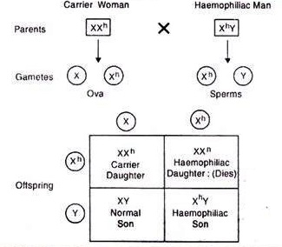
HAEMOPHILIA – sex-linked recessive disease
A single protein that is a part of the cascade of proteins involved in the clotting of blood is affected.
In affected individual, a simple cut will result in non-stop bleeding.
Heterozygous female (carrier) can transmit the disease to son.
Possibility of female becoming a haemophilic is extremely rare.

Slide 5
NEET BASED POINTS

Slide 6
TYPES OF HAEMOPHILIA
Hemophilia A: Caused by a lack of the blood clotting factor VIII; approximately 85% of hemophiliacs have type A disease.
Hemophilia B: Caused by a deficiency of factor IX.
Hemophilia C: Some doctors use this term to refer to a lack of clotting factor XI
Von Willebrand disease: A part of the factor VIII molecule known as von Willebrand factor or ristocetin cofactor is reduced.

Slide 7
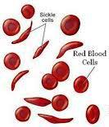
SICKLE-CELL ANAEMIA
Autosome linked recessive trait
It can be transmitted from parents to the offspring when both the parents are carrier for the gene.
Disease is controlled by a single pair of allele, Hb^{A} and Hb^{S}.
Hb^{S} Hb^{S} homozygous shows the diseased phenotype.

Slide 8
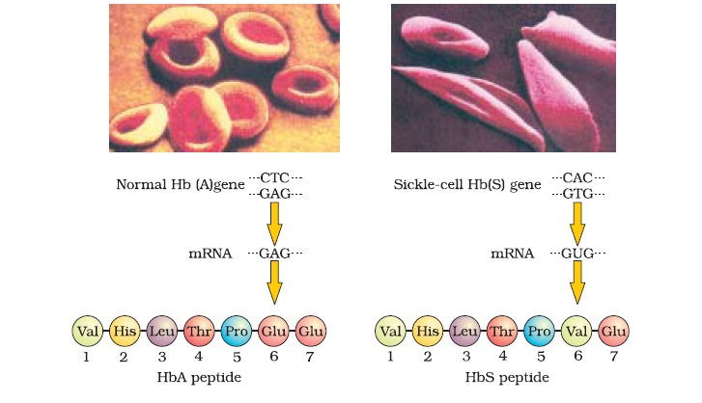
SICKLE CELL ANAEMIA
Genetic disorder caused by a defective allele (Hb^{A}) on chromosome no 11.

Slide 9
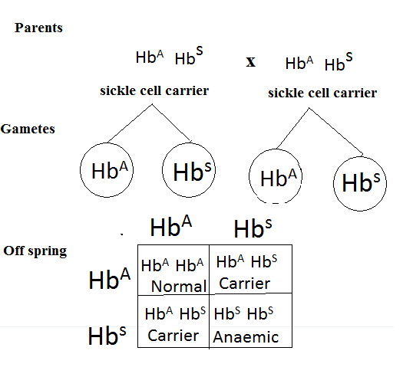

Slide 10
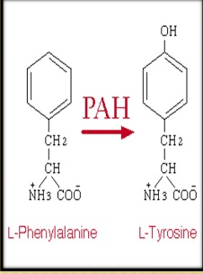
Phenyl keto uria (PKU)
Inborn error of metabolism, autosomal recessive trait.
Affected individual lacks an enzyme that converts the amino acid phenylalanine into tyrosine.
Due to which, phenylalanine gets accumulated and converted into phenylpyruvic acid and other derivatives.
This causes mental retardation.

Slide 11
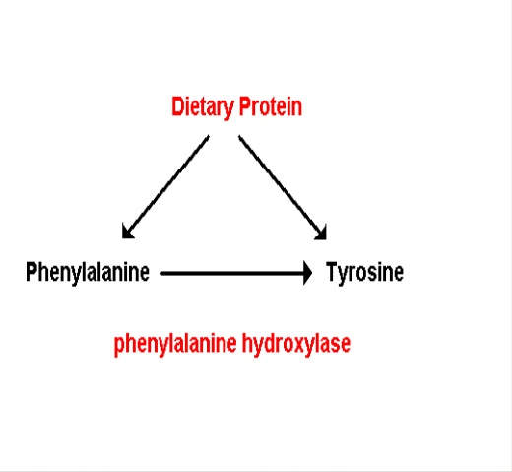

Slide 12
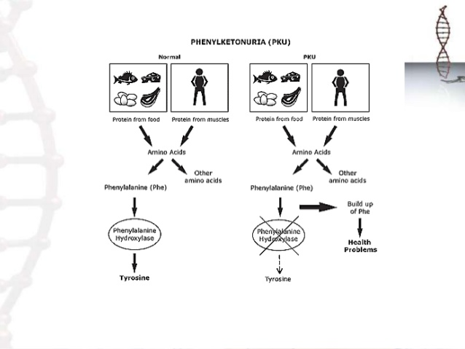

Slide 18
Human genetic disorders due to genetic abnormality
1. Phenyl ketouria
2. Alkaptomuria
3. Neurofibromatosis
4. Albinism
5. Galactosemia
6. Marfan’s syndrome
7. Gaucher’s disease
8. Tay scch’s disease
9. Sickle cell anaemia
10.Huntington’s disease
11.Thalassemia
12. Alzheimers disease
13. Cyctic fibrosis
14.Taste blindness of PTC

Slide 21
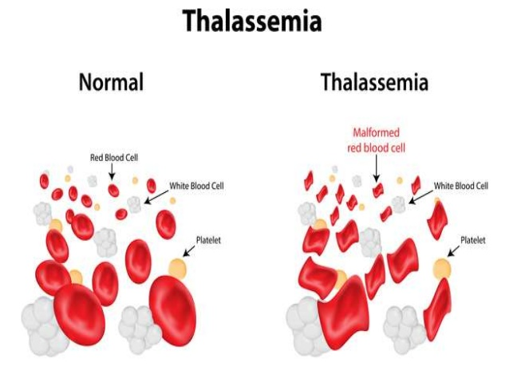

Slide 22
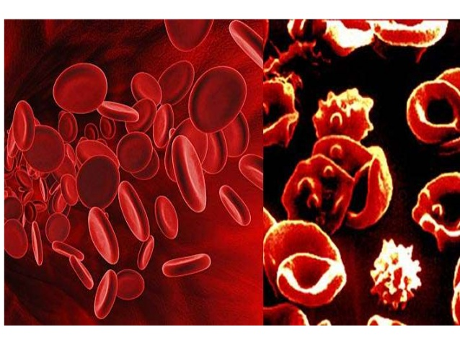

Slide 25
CHROMOSOMAL DISORDERS
It is caused due to absence or excess or abnormal arrangement of one or more chromosomes.
Aneuploidy – failure of segregation of chromatids during cell division cycle results in the gain or loss of chromosome.
Polyploidy – Failure of cytokinesis after telophase stage of cell division results in an increase in a whole set of chromosomes in an organism.

Slide 26
Down’s syndrome
Down’s syndrome – gain of extra copy of chromosome 21 (trisomy 21)
It was first described by Langdon Down (1866).
Affected individual is short with small round head, furrowed tongue and partially open mouth.
Broad palm with characteristic palm crease.
Physical, psychomotor and mental development is retarded.

Slide 27
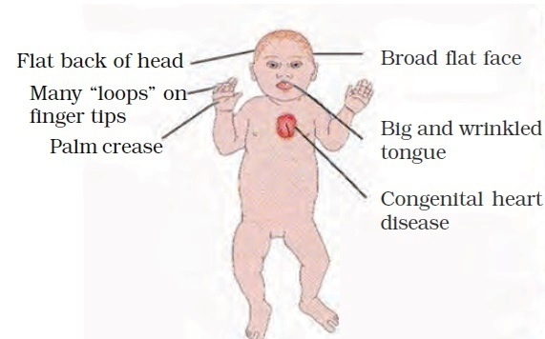
Down’s syndrome

Slide 28
Turner’s syndrome – loss of an X-chromosome in human females i.e. 45 with XO
Such females are sterile as ovaries are rudimentary
Klinefelter’s syndrome – presence of an additional copy of X-chromosome resulting into karyotype, 47, XXY.
Sterile individuals

Slide 29
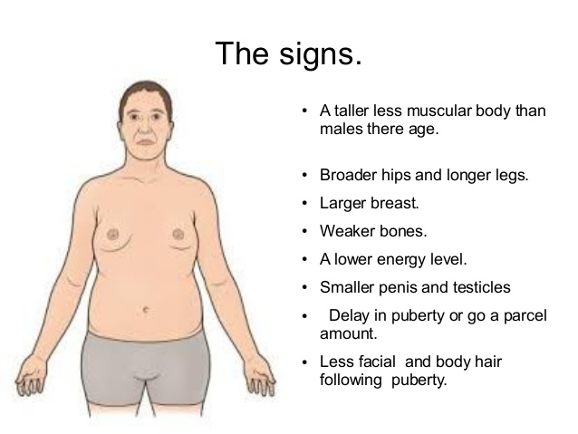

Slide 30
Turner’s syndrome
Result of monosomy X producing an XO karyotype.
1/5000 live births.
Only known monosomy in humans.
Normal intelligence.
Sterile

Slide 31
